Slide 1

DATA ANALYSIS DECK FOR TWEETS DATA
Jan 24,2025
Punith P S
Data Analysis

Slide 2
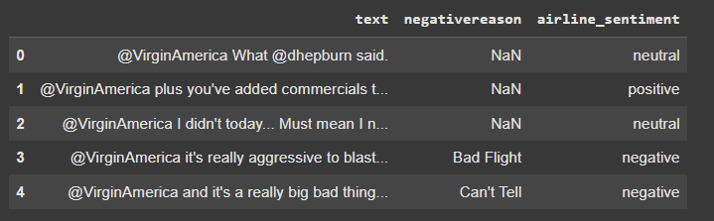
DATA ANALYSIS DECK
Relevant Columns for Model Building
Total Columns : 15
Relevant Columns : 3 (20 %)
Data Volume : 3.01 MB
Column Names :
Text (string) → Independent
Negative Reason (string) → Independent
Airline_Sentiment (string)→ Dependent
Data Analysis

Slide 3
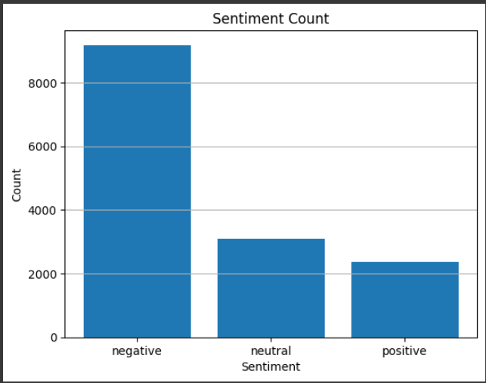
DATA ANALYSIS DECK
Sentiment Count
Negative : 9178
Positive: 2363
Neutral :3099
Comments:
The data has a lot negative comments as compared to positive and neutral comment which shows that data is biased
Data Analysis

Slide 4
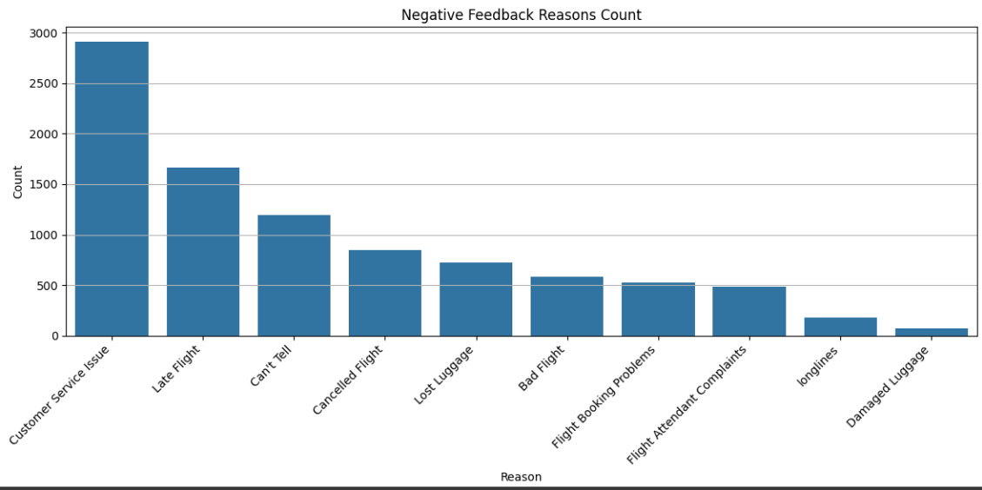
DATA ANALYSIS DECK
The common negative feedbacks
Customer Service Issue 2910
Late Flight 1665
Can't Tell 1190
Cancelled Flight 847
Lost Luggage 724
Bad Flight 580
Flight Booking Problems 529
Flight Attendant Complaints 481
longlines 178
Damaged Luggage 74
Comments:
The Customer Service Issue is the common negative feedbacks from the customers because of a lot of delayed flights customer service got hamperred
Data Analysis

Slide 5
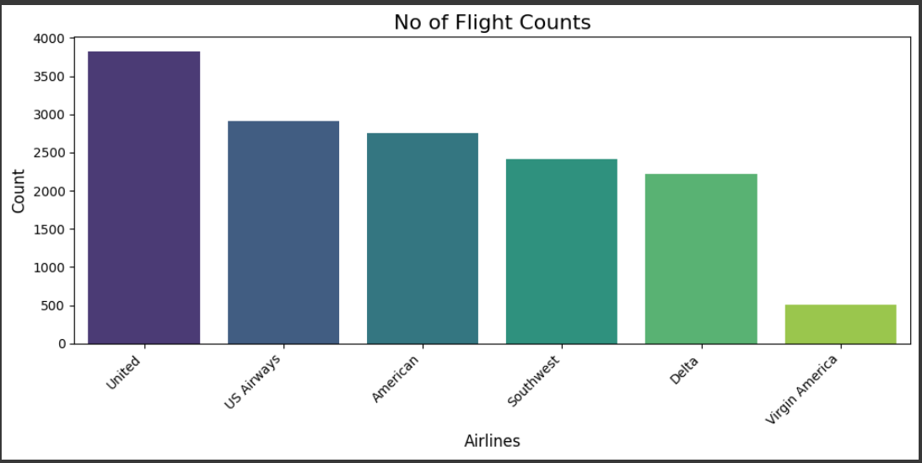
DATA ANALYSIS DECK
Different airlines are present in the dataset
American Airlines
Delta Airlines
Southwest Airlines
US Airlines
Virgin America Airlines
United Airlines
Data Analysis

Slide 6
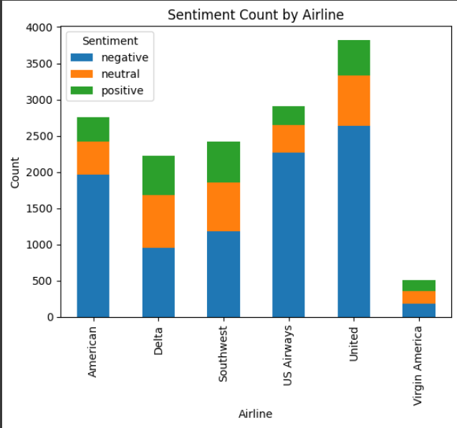
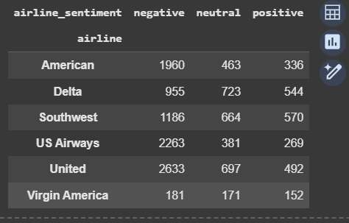
DATA ANALYSIS DECK
The no. of sentiments of each airline from the data?
Comments:
The Maximum no of negative feedback is for United Airlines
The Maximum no of neutral feedback is for Delta
The maximum no of Positive feedback is for Southwest
Data Analysis

Slide 7
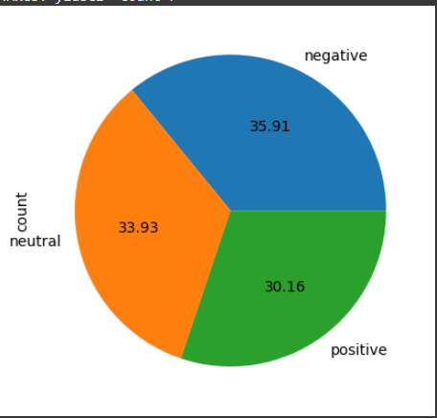
DATA ANALYSIS DECK
From your analysis, which airline do you feel is doing the best
The best Airline is Virgin America with Most Positive feedback i.e 30.16%
Data Analysis

Slide 8
DATA ANALYSIS DECK
Specific day where a lot of negative feedbacks :
Feb 22,2015
Sunday was another messy day for air travel. But Monday was already looking just as bad, especially for fliers scheduled to fly to or through Dallas
Sources: https://www.wusa9.com/article/news/nation/storms-more-than-1000-flights-already-grounded-for-monday/65-203527459
Data Analysis

